Slide 1
Improving CI/CD for
Kata Containers
Students: Anna Finn, James Knee, Chris Krenz, Alicja Mahr, Xiteng Yao
Mentors: Aurelien Bombo, Archana Choudhary, Saul Paredes
Notes:
CHRIS

Slide 2
Project Background
Kata containers are developed by an open source community
Focused on developing a secure container runtime environment
Lightweight virtual machines that act like containers
Provide a deeper workload isolation and better security
Our focuses in this project are:
Developing a dashboard to view recent tests on the CI pipeline
GitHub bot to automate Kata Container CI tasks
Notes:
CHRIS
Scope of project has broadened somewhat since the original

Slide 3
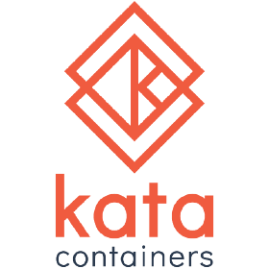
Kata Containers
An open-source project that provides lightweight VM for container like experiences
Enhanced security compared to conventional containers
Higher performance comparable to conventional VMs
Compatibility with existing container environments
Notes:
XITENG
Introduction to Kata Containers
Lightweight Virtual Machines for Containers
Combines the speed of containers with the security of virtual machines.
Enhanced Security:
Provides hardware-enforced isolation between workloads using virtualization technology.
Seamless Integration:
Compatible with existing container ecosystems like Docker and Kubernetes.
Efficient Performance:
Offers fast boot times and minimal resource overhead similar to traditional containers.

Slide 4
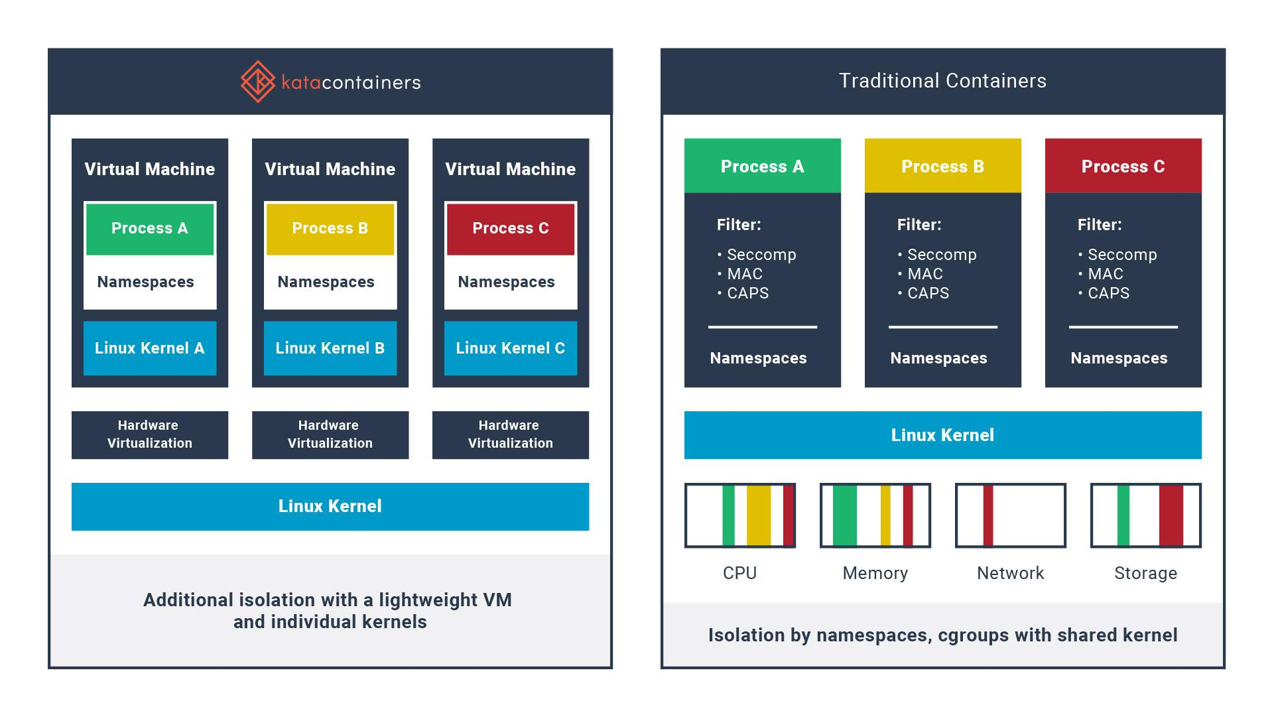
Notes:
XITENG
Unlike traditional containers, Kata Containers run inside lightweight VMs.
Inside each VM, an agent runs, managing container processes inside the VM. The agent receives gRPC calls from the Kata Shim to perform actions like starting or stopping containers.

Slide 5
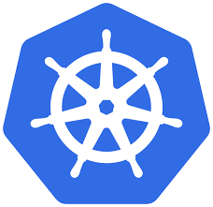
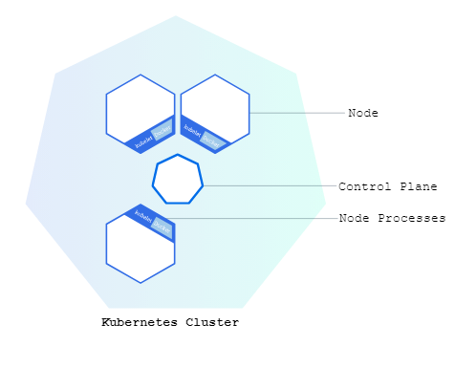
Kubernetes
Open source container orchestration platform
Automated deployment, scaling, and management of containerized applications
Self healing
Load Balancing
Automated rollout and rollback
Notes:
XITENG
Introduction to Kubernetes
Open-Source Container Orchestration Platform
Automates deployment, scaling, and management of containerized applications.
Key Features:
Self-Healing: Automatically restarts failed containers and replaces unresponsive nodes.
Load Balancing & Service Discovery: Distributes network traffic for stable deployments.
Automated Rollouts and Rollbacks: Manages updates with zero downtime.
Declarative Configuration: Uses YAML files for infrastructure as code.

Slide 6
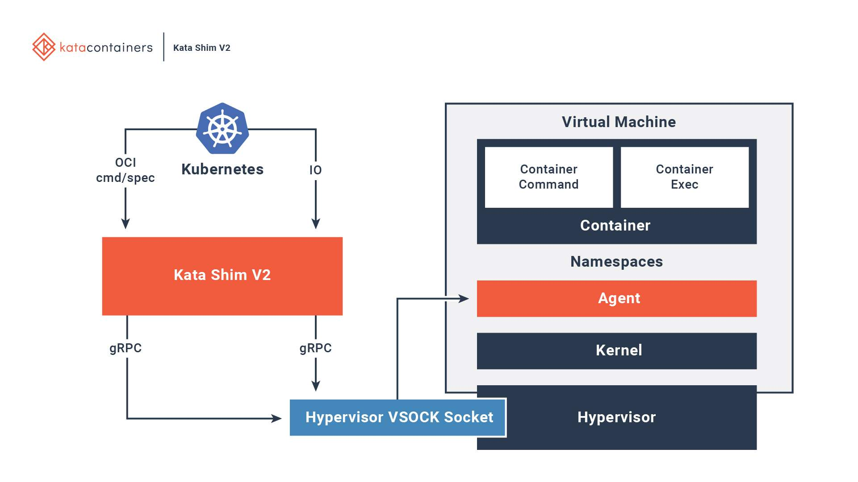
Notes:
JAMES
Kubernetes: Manages the lifecycle of containers using the OCI (Open Container Initiative).
Kata Shim V2: Acts as a proxy between the Kubernetes container runtime and the virtual machine running the container. OCI commands/specs are passed from Kubernetes to the Kata Shim, which translates them into gRPC calls (or Google Remote Procedure Calls–a modern, high-performance, open-source framework for inter-process communication (IPC) between applications.)
Hypervisor: Kata Containers rely on a hypervisor (we will be using QEMU) to manage the lightweight VMs, ensuring strong isolation and superior security compared to a traditional container.
VSOCK: Enables fast and secure communication between the Kata Shim and the VM, bypassing traditional networking overhead and efficient gRPC communication between the Kubernetes runtime (outside) and the agent inside the VM.
Summary
Kubernetes sends container commands.
Kata Shim V2 translates those commands into gRPC calls for the VM.
The agent inside the VM runs container workloads within lightweight VMs for enhanced security.
VSOCK provides efficient communication between the Kata Shim and the VM.

Slide 7



High Level Project Diagram
CI Dashboard
Test statuses
Access PRs
GitHub
PR interfacing
Bot actions
Test Environments
Kubernetes
Kata Containers
Notes:
CHRIS
https://github.com/kata-containers/kata-containers/blob/main/ci/README.md
The different workflows
Jobs that run automatically when a PR is raised
Jobs that require a maintainer's approval to run
The different runners
Cost free runners: Those are the runners provided by GIthub itself, and those are fairly small machines with no virtualization capabilities enabled -
Azure small instances: Those are runners which have virtualization capabilities enabled, 2 CPUs, and 8GB of RAM. These runners have a "-smaller" suffix to their name.
Azure normal instances: Those are runners which have virtualization capabilities enabled, 4 CPUs, and 16GB of RAM. These runners are usually garm ones with no "-smaller" suffix.
Bare-metal runners: Those are runners provided by community contributors, and they may vary in architecture, size and virtualization capabilities. Builder runners don't actually require any virtualization capabilities, while runners which will be actually performing the tests must have virtualization capabilities and a reasonable amount for CPU and RAM available (at least matching the Azure normal instances).

Slide 8

High Level Project Diagram
CI Dashboard
Test statuses
Access PRs
GitHub
PR interfacing
Bot actions
Test Environments
Kubernetes
Kata Containers
Prow
CI/CD Pipeline
GitHub <> Kata
Notes:
CHRIS
Prow is a Kubernetes based CI/CD system that allows for GitHub automations.
Allows developers to directly interact with the test environment, making tests easier to configure and run, and allowing developers to submit commands to the bot by adding comments or labels to the PRs.

Slide 9
User Flow Diagram
User Submits PR
Prow Initiates Tests
Results Sent to GitHub
User Submits Commands
User Views Dashboard
Can customize tests by labeling PR.
Based on labels provided by user.
Prow labels the PR with results.
e.g. add ‘/retest’ comment to PR.
More dynamic and graphical interface.
Notes:
CHRIS
Simple example of a how a user, which is a Kata Containers developer, would interact with this CI system.

Slide 10
Dashboard
Currently, the Dashboard:
Summary of all jobs are displayed
Content Delivery Network (CDN) Datatable
Runs on a GitHub IO page (code hosted on GitHub)
Dynamic page with HTML and JS
Fetches test data from Github
Updates nightly
Notes:
ANNA
The first part of the project we’re developing is the dashboard. Currently, the dashboard displays a summary of the jobs run through Github, including the number of runs, passes, fails, and skips. The webpage is hosted on a github IO page and dynamically fetches the test data from github, which is updated nightly and the data itself is displayed in a table through CDN’s API.

Slide 11
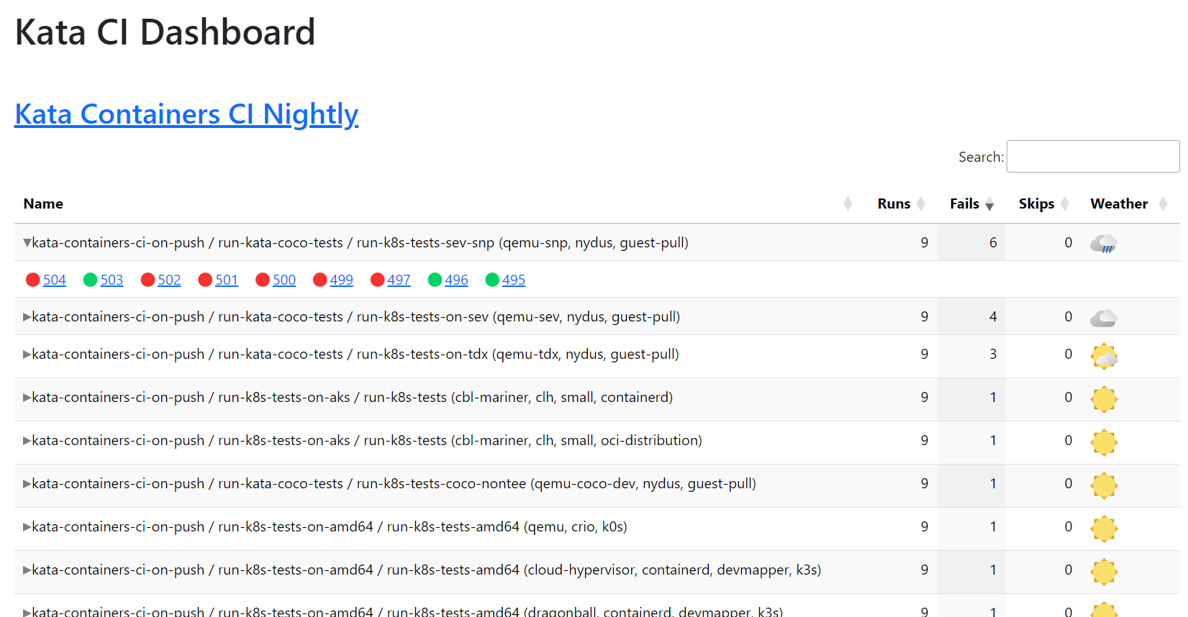
Notes:
ANNA
This is the original dashboard developed for Kata continuous integration
It simply shows the jobs with a summary as well as an optional drop-down section to display the individual runs.
Since it uses the CDN datatable, it includes sorting based on the column values as well as searching based on the job name.
The weather simply indicates how well the test has been performing over the runs observed (with better weather meaning more passes)

Slide 12
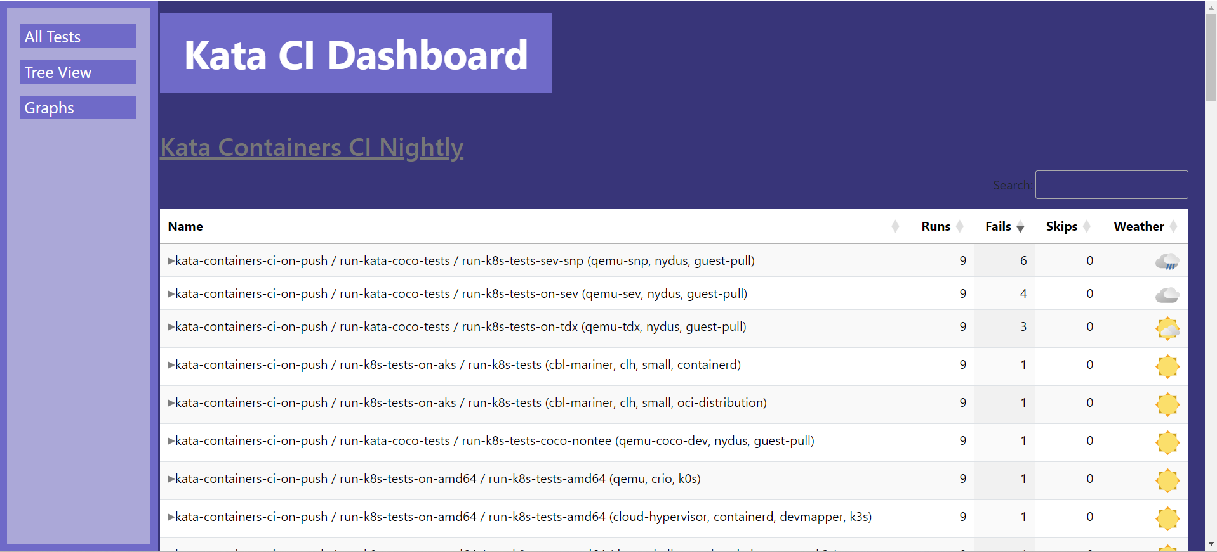
Notes:
ANNA
Currently, we added basic HTML styling as well as a sidebar navigation menu by forking and cloning the repository the source code was hosted from.

Slide 13
Next Steps
Further develop the CI Dashboard
Add new filtering options
Test results indexed by PR/nightly run
Implement Tree View
Implement collapse/expand all
Revamp to use Node/React
Notes:
ANNA
Moving forward, we want to add filtering options. For instance, some of the tests aren’t required, so we could filter by required tests.
Moreover, we want to add additional sorting. Currently, nightly results are sorted by test name. We aim to also sort by pull request or even by the nightly run if we integrate multiple nightly runs into the display.
We also want to implement a tree view to display the jobs with a collapse all/expand all option. However, before we move forward we must discuss with our mentor about switching to Node and React to better facilitate these new implementations.

Slide 14
Roadblocks
GitHub Pages (Static Page Hosting)
DataTables library lacks support for tree view
Pure HTML/JS + jQuery
General Clarification
Notes:
ALICJA

Slide 15

Stretch Goals
GitHub Bot
Prow: Kubernetes-based CI/CD system with GitHub automations
Hosting: Azure Kubernetes Service, MOC
GitHub commands via comments
Auto add/remove PR labels
Trigger tests based on labels
Notes:
ALICJA
Prow Documentation: “Prow is a Kubernetes based CI/CD system. Jobs can be triggered by various types of events and report their status to many different services. In addition to job execution, Prow provides GitHub automation in the form of policy enforcement, chat-ops via /foo style commands, and automatic PR merging.” Aurelien: “As mentioned in the original proposal, a big win would be to implement a CI bot to help us automate things and run commands via Github comments. One way to do this would be to set up Prow (https://docs.prow.k8s.io/docs/getting-started-deploy/), which is used in the Kubernetes and containerd project for example. Prow is deployed in a Kubernetes cluster however, meaning we'd have to host this cluster with some cloud provider, which isn't free. We could probably use the Azure Kubernetes Service, as Microsoft is already sponsoring the Kata project. However that would incur a cost against the current sponsoring, which we should estimate. This could be a good first step here.”

Slide 16
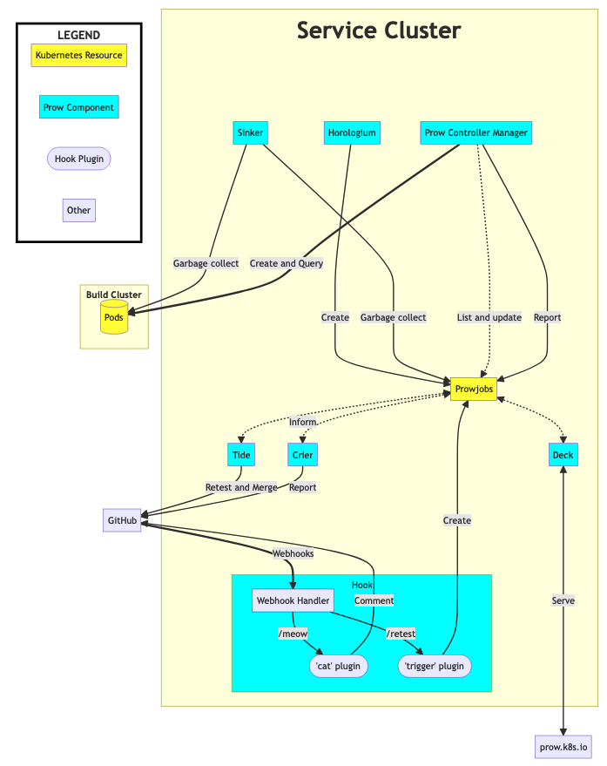
Prow
Kubernetes-based CI/CD
Allows use of GitHub automations
policy enforcement
chat-ops via /foo style commands
automatic PR merging
Notes:
ALICJA
~Prow Process
PR Created: A contributor opens a PR in the Kata Containers GitHub repo.
Prow Triggers Tests: Prow automatically triggers CI jobs defined for Kata Containers (e.g., tests that run Kata Containers on different configurations).
Bot Feedback: The Prow GitHub bot comments on the PR with test results. Developers can use bot commands (e.g., /retest) to interact with it.
Merge After Approval: Once tests pass and approvals are obtained (e.g., via /approve), Prow can merge the PR automatically.
“Prow in a Nutshell
Prow creates jobs based on various types of events, such as:
GitHub events (e.g., a new PR is created, or is merged, or a person comments “/retest” on a PR),
Pub/Sub messages,
time (these are created by Horologium and are called periodic jobs), and
retesting (triggered by Tide).
Jobs are created inside the Service Cluster as Kubernetes Custom Resources. The Prow Controller Manager takes triggered jobs and schedules them into a build cluster, where they run as Kubernetes pods. Crier then reports the results back to GitHub.”
Overview of Diagram
GitHub Interaction:
Webhooks trigger actions when pull requests (PRs) are opened, commented on, or updated.
GitHub commands like /retest or /meow (which are handled by Prow plugins) can be used in PR comments to trigger certain CI/CD workflows.
Prow Components:
Webhook Handler: Receives webhooks from GitHub and forwards them to Prow for further actions.
Tide: Handles retesting and automatic merging of PRs if all conditions are met.
Crier: Reports status and results (e.g., pass/fail) back to GitHub.
Horologium: Manages scheduled jobs, creating new ones at specific intervals.
Sinker: Cleans up old jobs and resources, such as Pods, after they are no longer needed.
Job Management:
Prowjobs: A key concept in Prow. These are Kubernetes CRDs (Custom Resource Definitions) that define and track the CI/CD jobs.
Build Cluster: Where the actual job execution (e.g., running tests in Pods) happens.
Pods: The jobs are run as Pods inside the Kubernetes cluster.
Deck: The dashboard for visualizing job status and results.
Summary: This diagram illustrates how Prow integrates GitHub, Kubernetes, and various plugins to automate continuous integration (CI) tasks like testing, retesting, reporting, and merging PRs.

Slide 17
Future Sprints
Sprint 2: Substantive improvements to existing CI Dashboard (visualizations and health checks) and research into a GitHub Bot implementation
Sprint 3: Creation of placeholder GitHub Bot and further improvements to the Dashboard
Sprint 4: Implement labels for the PRs and, if time permits, implementation of GitHub Bot commands
Sprint 5: Finalize and test features
Notes:
JAMES

Slide 18
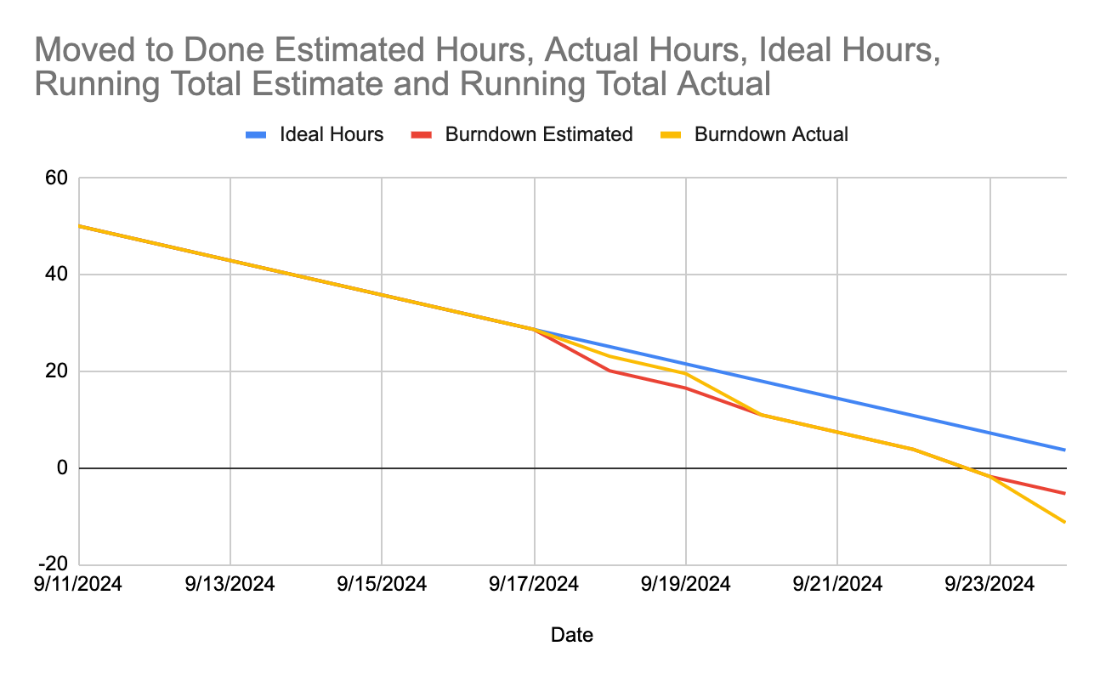
Burndown Chart
Notes:
JAMES

Slide 19
Q&A

Slide 20
References
Kubernetes cluster tutorial: https://kubernetes.io/docs/tutorials/kubernetes-basics/create-cluster/cluster-intro/
Kubernetes and containers: https://kubernetes.io/
Kata containers: https://katacontainers.io/learn/
Kata repo: https://github.com/kata-containers/kata-containers
Installation guide: https://github.com/kata-containers/kata-containers/tree/main/docs/install
Community info (incl. weekly meeting and Slack channels): https://github.com/kata-containers/community
Architecture: https://github.com/kata-containers/kata-containers/tree/main/docs/design/architecture
Architecture 3.0: https://github.com/kata-containers/kata-containers/tree/main/docs/design/architecture_3.0
Contributing guide: https://github.com/kata-containers/community/blob/main/CONTRIBUTING.md
CI guide: https://github.com/kata-containers/kata-containers/blob/main/ci/README.md
Prow: https://docs.prow.k8s.io/docs/getting-started-deploy/
Porters: https://portersrc.github.io/

